Slide 1
Making this resource work for you
Prior to teaching this lesson, please refer to the ‘Unit Overview and Planning Document’.
Further guidance on planning Science Mastery lessons can be found in the detailed planning guidance document.
Refer to the ‘notes’ section on each slide for useful information, including suggested expositions, pedagogical content knowledge, suggested questions, answers and more. Consider using presenter mode so you can see this guidance throughout the lesson.
The introduction slides can be adapted to suit your teaching style and the needs of your class.
Before the lesson, adapt the fix-it slide to address any misconceptions identified in the previous lesson’s exit ticket.
Choose from the suggested activities to suit your class. The intention is not that you complete all of these, but that you select those which ones are most appropriate for your students. It may be appropriate to further adapt activities for your students.
These lessons are designed to occupy approximately 1 hour. To adapt for a shorter or longer lesson duration we advise you to adapt the activity section accordingly.
Please consider using the final slide to send feedback about this lesson or examples of PowerPoints that you have adapted to our design team. Your feedback is used to improve Science Mastery for all of our teachers and students. We appreciate all suggestions and comments.
Thank you for reading!
The Science Mastery Team

Slide 2
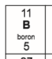
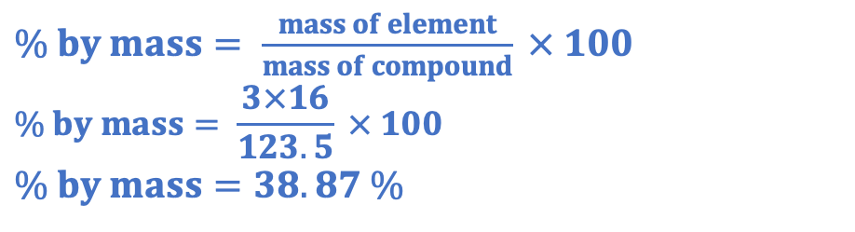
Mole Calculations
Answer the questions below.
State the relative atomic mass of boron.
State how many particles are in one mole of a substance.
State the mass in grams of boron that would contain this many particles.
Calculate the M_{r} of copper carbonate (CuCO₃). Cu=63.5, C=12, O= 16
Calculate the percentage by mass of oxygen in copper carbonate.
11
6.02 x 10²³
11 g
63.5 + 12 + (3x16) = 123.5
$\% by mass= \frac{mass of element}{mass of compound} × 100$
$$\% by mass= \frac{3×16}{123.5} × 100$$
$$\% by mass=38.87 \%$$
Notes:
Big idea: Reactions rearrange matter
Foundation: Calculate the relative formula mass of sulfur dioxide (SO₂).
Stretch: State how many atoms there would be in 18 g of water.
Answers:
Foundation: C
Stretch: Mr of water = 18, so in 18 g there is one mole of water. But this is water molecules, and there are 3 atoms in each water molecule so 3 x 6.02 x10²³ = 1.806 x10²⁴.

Slide 3
Mole Calculations
Do Now:
State the relative atomic mass of boron.
State how many particles are in one mole of a substance.
State the mass in grams of boron that would contain this many particles.
Calculate the M_{r} of copper carbonate (CuCO₃). Cu=63.5, C=12, O= 16
Calculate the percentage by mass of oxygen in copper carbonate.
Drill:
State Avogadro’s number.
Calculate 3 x 4.83 x10¹¹. Write your answer in standard form.
Calculate 0.25 x 4.83 x10¹¹. Write your answer in standard form.
Notes:
Drill answers:
6.02 x 10²³
1.449 x 10¹²
1.2075 x 10¹¹

Slide 4
Mole Calculations
Read Now:
In one mole of any substance there are 6.02 x10²³ particles. This can be atoms, molecules or ions. For example, one mole of water contains 6.02 x10²³ molecules of water and one mole of potassium contains 6.02 x10²³ atoms of potassium. The relative atomic mass of an element tells you the mass of that element (in grams) that contains exactly this number of atoms. The relative atomic mass of Neon is 20, so 20 g of Neon contains one mole (6.02 x10²³ atoms). The relative formula mass of a compound tells you the mass of the compound in grams that contains exactly this number of molecules or particles. The relative formula mass of sulfur dioxide (SO₂) is 64 (S=32, O=16), so 64 g of sulfur dioxide contains one more (6.02 x 10²³) molecules of sulfur dioxide.
State how many particles are in one mole of a substance.
Describe the relationship between relative atomic mass and the mass in grams that contains one mole of a substance.
Show how the relative formula mass of sulfur dioxide is 64.
Explain the difference between relative atomic mass and relative formula mass.

Slide 5
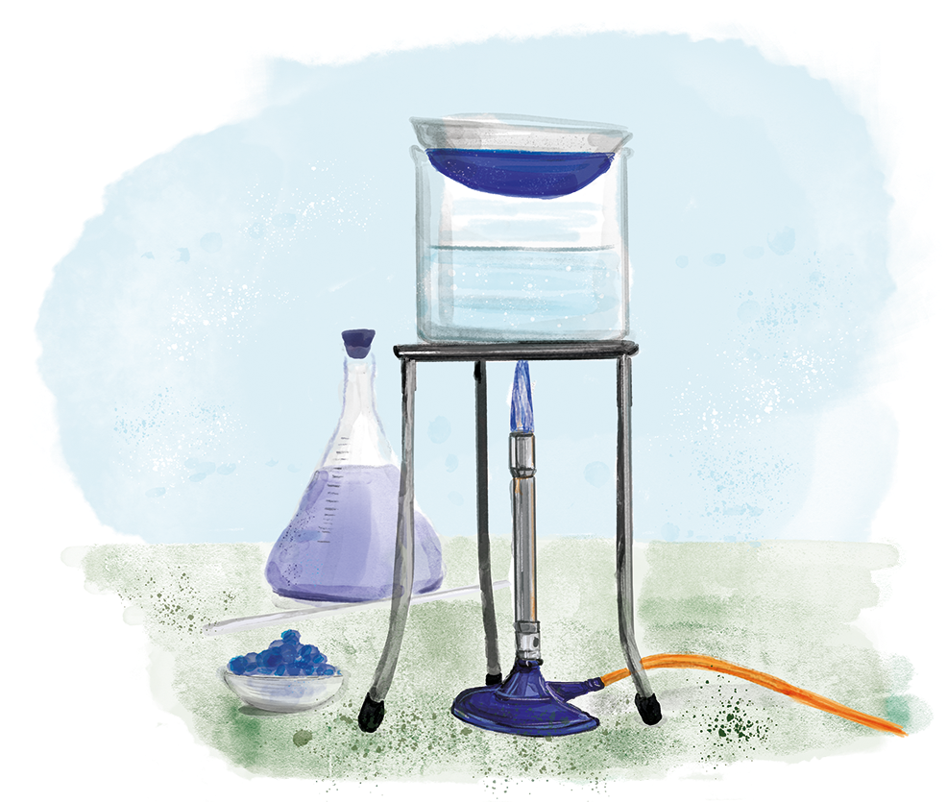
C4.3.3
03/02/2025
(HT) Mole Calculations
C4.3.1 Prior Knowledge Review
C4.3.2 (HT) Introducing the Mole
C4.3.3 (HT) Mole Calculations
C4.3.4 PKR: Concentration
C4.3.5 TIF: Calculating Concentration
C4.3.6 TIF: Calculating an Unknown Concentration
C4.3.7 (HT) Amounts of Substances in Equations
C4.3.8 (HT) Limiting Reactants
C4.3.9 PKR: Reactions of Acids
C4.3.10 Acids, Alkalis and Neutralisation
C4.3.11 TIF: Acid-Alkali Titration
C4.3.12 TIF: Acid-Alkali Titration Analysis
C4.3.13 TIF: Titration Calculations
C4.3.14 (HT) Strong and Weak Acids
C4.3.15 TIF: Volumes of Gases
Notes:
Big idea: Reactions rearrange matter
In the previous lesson, students were introduced to the idea of moles as a quantity. In this lesson, they will apply the relationship between relative atomic mass, mass in grams and number of moles.
Suggested Hook:
If 12 g of carbon contains one mole, how many moles are there in 24 g of carbon? Or 6 g of carbon?

Slide 6

Following this lesson, students will be able to:
Recall the equation linking mass, M_{r} and number of moles.
Convert amounts of substance in mol to their mass, given the M_{r}.
Calculate the amount of substance in a given mass, in mol.
Key Words:
mole
mass
amount
relative formula mass
Avogadro’s number
Notes:
Guidance:
See unit overview document and planning guidance to see how these objectives are typically assessed at GCSE, including examples of what students should be able to do following this lesson.
Planning for different needs:
The learning objectives given on this slide are suggested based on the most common requirements for exams, however they can be adapted based on the needs of different classes.
For best practice, the unit preparation booklet should be used to determine the appropriate focus of lessons within the unit.
While it is not possible to explicitly split content into levelled grades, we recommend that lesson objectives can be classified as critical, core or stretch.
Critical: the content or skill is essential for all students to be able to progress.
Core: the content or skill is important for students to progress, but other opportunities may be available to revisit it.
Stretch: the content or skill may not be essential for all students but is important for students aiming for the highest grades.
Key skill: this is a crucial skill being developed in this unit as part of the skill mapping
C4.3.3 Lesson Objectives:
Critical: Recall the equation linking mass, M_{r} and number of moles.
Core: Convert amounts of substance in mol to their mass, given the M_{r}.
Core: Calculate the amount of substance in a given mass, in mol.

Slide 7
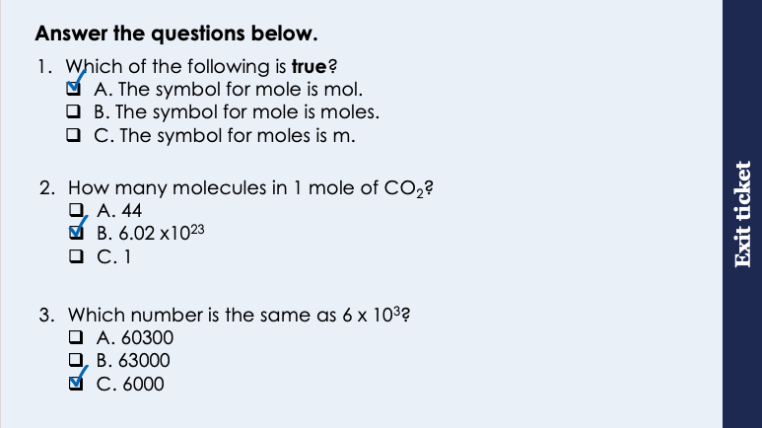
This is the fix-it portion of the lesson
The fix-it is an opportunity to respond to gaps in knowledge, especially those identified by the pre-unit quiz.
The teacher should customise this slide as needed, to facilitate
reteach, explanation, demonstration or modelling of ideas and concepts that students have not yet grasped or have misunderstood.
practise answering specific questions or of key skills.
redrafting or improving previous work.
Notes:
Purpose: to spend time on any gaps identified in previous learning from exit ticket.
Fix-it guidance from previous exit ticket:
Q1. Answer: A
If students answer B or C, they have not identified the units for moles. To fix-it, review the definition and the units. .
Q2. Answer: B
If students answer A, suggests the student is confusing ‘number of molecules’ with the relative formula mass. To fix it, give students some compounds and elements and ask them to identify the RFM for each. If students answer C, they have misinterpreted the meaning of mole, so have suggested that there is 1 mole in a mole, but the question is asking about the number of molecules. To fix-it, give students further practice of identifying the number of atoms in 1 mole of different elements and compounds.
Q3. Answer: C
If students answer A or B, it shows the need more practice of standard form conversions. To fix-it, give students more practice of converting between written out numbers and standard form.

Slide 8
What is the relationship between moles, mass and M_{r}?
Take a look at the values in this table.
How did they calculate the mass?
What is the mathematical relationship between moles, mass and M_{r}?
Multiplied the number of moles by the M_{r}
1 mole of carbon dioxide (M_{r} = 44) | 44 g
2 moles of carbon dioxide (M_{r} = 44) | 88 g
0.5 moles of carbon dioxide (M_{r} = 44) | 22 g
1 mole of water (M_{r} = 18) | 18 g
0.25 mole of water (M_{r} = 18) | 4.5 g
2 moles of X (M_{r} = 36.5) | 73 g
0.5 moles of Y (M_{r} = 80) | 40 g
Mass = number of moles x M_{r}
Notes:
Exposition type: explanation
Suggested exposition:
In the last lesson we looked at the concept of the mole. This is just the quantity that we use to describe 6.02 x 10²³ particles, like we would use the word dozen to describe 12 of something.
We learned that using the relative atomic mass of an element gives us the mass in grams that would contain one mole (so 6.02 x 10²³ particles).
For example, carbon has a relative atomic mass of 12, so 12 g of carbon would contain one mole.
Let’s look at some other substances and look at the relationship between moles, mass and relative formula mass. Remember that moles applies to any substance, not just an element. If it is a compound, the relative formula mass gives the mass in g that would contain one mole of a substance.
Give students some time to try and work out how these values in g were calculated.
NOTE: Students struggle with the concept of moles – especially if it is treated purely as a mathematical concept.
This is the recommended teaching sequence from the Royal Society of Chemistry which follows on from last lesson’s work – for more information please look at the CPD available on their website for Quantitative Chemistry https://www.rsc.org/cpd/resource/RES00001328/quantitative-chemistry
Lesson notes: This is a metacognition exercise. Get students to discuss the table in groups and you can use white boards to answer if you have them available – it shouldn’t take them long to work out that mole x Mr = mass – this is an important step before moving onto the next slide which introduces the calculations. They don’t need to have written anything down from this slide.

Slide 9
How can we use the equation to calculate the mass or number of moles?
Number of moles = mass
M_{r}
What is the amount of substance in 64.0 g of O₂? (M_{r} = 32)
Number of moles = mass ÷ M_{r}
= 64.0 g ÷ 32
= 2 mol
What is the mass (g) of 0.5 moles of MgCO₃? (M_{r} = 84)
Mass = number of moles x M_{r}
= 0.5 mol x 84
= 42 g
Remember: amount of substance is measured using the mole
Remember: the symbol for moles is mol
Notes:
Exposition type: explanation
Suggested exposition:
How can we use this relationship to calculate the mass or the number of moles then? We don’t ever need to calculate the relative formula mass from an equation, because we can always work that out using our chemical formula and values from the periodic table.
We can use this equation (that students need to remember): the number of moles = mass (in grams)/relative formula mass.
This equation can be a little bit confusing because there are lots of Ms and Ns.
Let’s look at an example.
What is the amount of substance is 64 g of O2? Oxygen exists as a diatomic element, with each molecule containing two oxygen atoms.
When we say ’amount of substance’ this means how many moles, so how many particles are there. This is why we are so strict when students write amount, when they mean volume of a liquid or a mass, because amount has its own meaning in chemistry!
We can calculate the number of moles present using the mass in grams and the relative formula mass.
So 64 g of oxygen contains 2 moles.
The mass of one mole of substance is called the molar mass and is given the unit grams per mole (g/mol). To work out the molar mass of a compound you add together the relative atomic masses, which you will find on any periodic table. E.g. the molar mass of methane, CH₄ = 12 + 1 + 1 + 1 + 1 = 16 g/mol
Notes:
If students struggle with rearranging, it is useful to just get them to use the form at the top of the slide each time, substitute first and then solve algebraically, which is how we approach calculations in physics, rather than getting students to rearrange the formula.

Slide 10
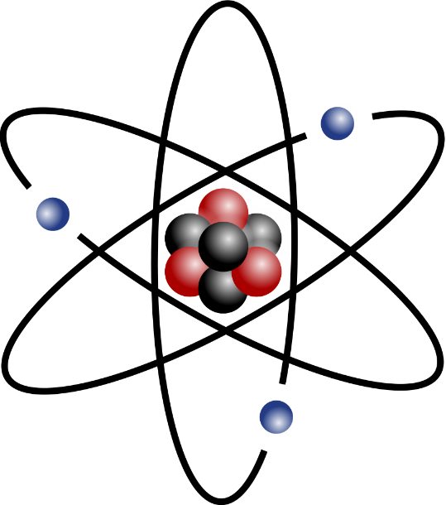
Let’s talk about moles.
Atoms of different elements have different masses. This is because they have different numbers of protons and neutrons.
Lead atoms are heavier than carbon atoms. Why?
Would 100 g of lead contain the same number of atoms as 100 g of carbon?
Imagine you measure out 100g of normal Mars bars and 100 g of mini Mars bars. Would 100g of normal Mars contain the same number of bars as 100g of mini Mars? Why?
Would 1 mol of lead contain the same number of atoms as 1 mol of carbon? Why?
12
C
carbon
6
207
Pb
lead
82
Notes:
Exposition type: explanation
Suggested exposition:
The atoms of each different element have a different mass. This is because they contain different numbers of protons and neutrons.
For example, lead atoms are heavier (have a greater mass) than carbon atoms.
Why?
Lead atoms contain many more protons and neutrons.
So would 100 g of lead contain the same number of atoms as 100 g of carbon?
No, there would be fewer lead atoms than carbon atoms, because each lead atom has a greater mass so there would be fewer of them needed to produce a mass of 1 g.
We can think about this with other things in real life:
Imagine you have mini mars bars and full size mars bars. This can be worth actually demonstrating.
So would 100 g of normal mars bars contain the same number of bars as 100 g of mini mars bars?
No, there would be fewer full sized mars bars, because each full mars bar has a greater mass so there would be fewer of them needed to produce a mass of 100 g.
Would 1 mol of lead contain the same number of atoms as 1 mol of carbon? Why?
Yes. 1 mole of any substance always contains 6.02 x 10²³ particles.
Notes:
Many students do not understand the concept of particle mass – that different elements have atoms with different masses. Therefore 1 g of one substance will have a different number of atoms in it than 1 g of another substance.
Image source:
CC@https://commons.wikimedia.org/wiki/File:Stylised_atom_with_three_Bohr_model_orbits_and_stylised_nucleus_(with_marks).svg

Slide 11
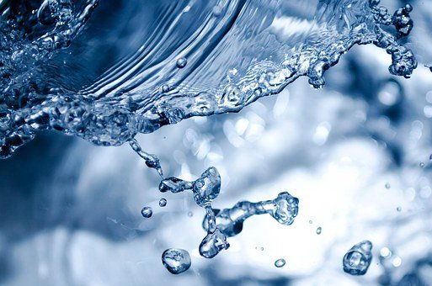
Describing Equations
Describe what happens in the following chemical equation using the idea of moles:
O₂ + 2H₂ → 2H₂O
Notes:
To get pupils explaining chemical equations in terms of moles. For added stretch you may want to give pupils the unbalanced equation first.
Listen to the way pupils describe the reaction to draw out any issues around their language. You may also want to get pupils thinking about the difference between this equation in molecules and moles (1 molecule of oxygen reacts with 2 molecules of hydrogen to produce a molecule of water, but in reality, it would be extremely rare for just a couple of molecules to be involved, hence why we use moles).
1 mole of oxygen reacts with 2 moles of hydrogen to produce 2 moles of water.
Suggested guidance:
Talk tasks can be used in a variety of ways to suit the particular needs of the students you are teaching. Through exchanging views with others, students develop their understanding of the science beyond what could be achieved individually.
Science classrooms that successfully integrate talk have the following features:
Science talk is a regular feature of lessons and is woven into classroom activities.
Students are paired or grouped strategically by the teacher to ensure productive interaction. This might take into consideration the students’ proficiency of the English language, how encouraging they might be to peers and their attainment in the topic. It’s a good idea to consider these pairings in the class seating plan.
Students are encouraged and supported to talk, but are not forced to talk.
The teacher should take on the role of a facilitator, engaging with conversations where necessary and encouraging or steering the conversation where needed.
Students are encouraged to use the language they have to express their ideas (e.g., everyday language, imperfect English, native language), but also to incorporate science specific terminology where this is more accurate or has been taught.
6. Scientifically inaccurate ideas are not dismissed by the partner or teacher; open discussion and further investigation are relied on to help students construct ideas that support them to progress in their scientific understanding.
7. Guidelines for behaviour during talk tasks are explicit and frequently reviewed. Rules for students might be:
Listen carefully to your partner
Take turns talking.
Speak one at a time, without interrupting.
Politely agree or disagree and explain why.
Politely point out if your partner has used a scientific word incorrectly, if they have explained the science incorrectly, or if there is a more accurate way to describe something.
If confused, ask questions.
Stay focused on the discussion topic.
Respond to one another.

Slide 12
What is wrong with the following answers? Re-write them correctly. (Q5 has more than one issue).
The student measured out the amount of HCl using a measuring cylinder.
The relative formula mass of MgO is 20.
The symbol for the mole is m.
2 moles of water molecules has a mass of 9 g (M_{r} = 18).
What is the amount of substance in 15 g of Li₂O?
M_{r} of Li₂O = 7 + 16 = 23
Number of moles = mass ÷ Mr
= 15 g ÷ 23
= 0.65 mole
16
O
oxygen
8
volume
24
Mg
magnesium
6
The relative formula mass of MgO is 40.
The symbol for the mole is mol.
0.5 mole of water has a mass of 9 g or 2 moles of water has a mass of 36g.
M_{r} of Li₂O = (7 x 2) + 16 = 30
Number of moles = mass ÷ Mr
= 15 g ÷ 30
= 0.5 mol
7
Li
lithium
3
Notes:
Purpose: to check that key knowledge from the introduce phase has been learnt and understood.

Slide 13
Drill
State the unit for moles.
State the equation that links number of moles, mass and relative formula mass.
State the unit for mass.
Calculate the relative formula mass of sodium hydroxide (NaOH).
Calculate the number of moles in 120 g of sodium hydroxide.
Calculate the relative formula mass of magnesium chloride (MgCl₂).
Calculate the mass of 0.25 moles of magnesium chloride.
Notes:
Purpose: This is a knowledge drill. The purpose of this is to check that the critical knowledge is secure before pupils move onto independent practice.
Suggested guidance: There are a range of ways this could be done depending on time and ability range of the class:
Mini whiteboards
As full sentences in exercise books
As short answers in exercise books
In the pupil workbook
As pair talk
As cold call

Slide 14
Drill answers
mol
number of moles = mass/M_{r}
g
23+16+1 = 40
number of moles = mass/M_{r}, so 120/40 = 3 mol
24+(35.5 x 2) = 95
number of moles = mass/M_{r} so 0.25 = mass/95
mass = 23.75 g
Notes:
Purpose: This is a knowledge drill. The purpose of this is to check that the critical knowledge is secure before pupils move onto independent practice.
Suggested guidance: There are a range of ways this could be done depending on time and ability range of the class:
Mini whiteboards
As full sentences in exercise books
As short answers in exercise books
In the pupil workbook
As pair talk
As cold call

Slide 15
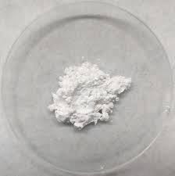
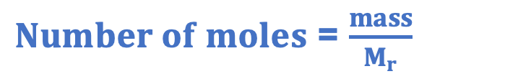
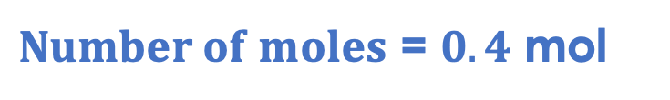
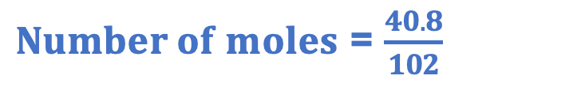
I: Calculating number of moles
A scientist has a sample of 40.8 g of aluminium oxide.
What is the chemical formula for aluminium oxide?
Al₂O₃
What is the relative formula mass of aluminium oxide?
(2 x 27) + (3 x 16) = 102
How many moles does the scientist have in their sample?
$Number of moles$ = $\frac{mass}{M_{r}}$
$Number of moles$ = $\frac{40.8}{102}$
$Number of moles$ = $0.4$ mol
Notes:
Purpose: The I-We-You section aims to support pupils to build skills that they most commonly need when answering questions associated with this knowledge in the assessment. This section is also used to interleave other content we expect pupils to know at this stage of their education in order that they build a big picture of the science they are learning.
For the ‘I’ activity, the teacher should model how to answer the question. They can do this by narrating their thinking process aloud, and making links to learning earlier in the lesson explicit.
For the ‘we’ activity, the teacher and students work though a similar example together, in order to prepare students to be able to answer a similar question independently.
Opportunities for the ‘you’ activity – independent practise – occur in the activity portion of the lesson once the student is secure enough to process independently.

Slide 16
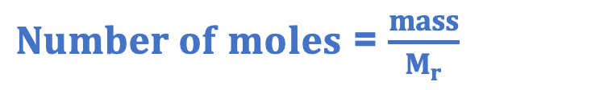
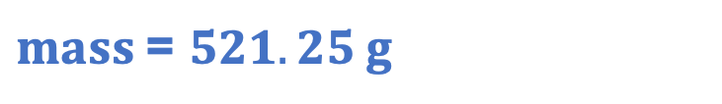

We: Calculating number of moles
A scientist has a sample of 2.5 moles of phosphorus pentachloride. The chemical formula for phosphorus pentachloride is Cl₅P.
What is the relative formula mass of phosphorus pentachloride?
(5 x 35.5) + 31 = 208.5
What mass does the scientist have in their sample?
$Number of moles$ = $\frac{mass}{M_{r}}$
$2.5$ = $\frac{mass}{208.5}$
$mass$= $521.25 g$
Stretch: how many atoms does the scientist have in their sample?
2.5 mol x 6.02 x10²³ = 1.505 x10²⁴ molecules
6 atoms per molecule so 6 x 1.505 x10²⁴ = 9.03 x10²⁴
Notes:
Purpose: The I-We-You section aims to support pupils to build skills that they most commonly need when answering questions associated with this knowledge in the assessment. This section is also used to interleave other content we expect pupils to know at this stage of their education in order that they build a big picture of the science they are learning.
For the ‘I’ activity, the teacher should model how to answer the question. They can do this by narrating their thinking process aloud, and making links to learning earlier in the lesson explicit.
For the ‘we’ activity, the teacher and students work though a similar example together, in order to prepare students to be able to answer a similar question independently.
Opportunities for the ‘you’ activity – independent practise – occur in the activity portion of the lesson once the student is secure enough to process independently.

Slide 17
You: Moles, molecules and atoms
Baking a mole cake
A chemist has written a cake recipe in moles! Convert the amount of substance to mass (0 d.p) for each of these ingredients.
(A_{r}: C = 12; O = 16; H = 1; Na = 23)
Ingredient | Formula | M_{r} | Mass (g)
0.585 moles of caster sugar | C₁₂H₂₂O₁₁ | 342
0.641 moles of margarine | C₂₀H₄₀O₂
1.250 moles of flour | C₆H₁₀O₅ | 160
0.040 moles of baking powder | Na₂CO₃
 | 200
312 | 200
 | 200
106 | 4
Notes:
There are many ‘mole day’ activities which can be found with a quick internet search, converting recipes is a typical one. Mole day is 23rd October between 6.02am and 6.02pm making the date 6:02 10/23 in the American style of writing dates. (can also be celebrated on June 2 or February 6 from 10.23am to 10.23pm.

Slide 18
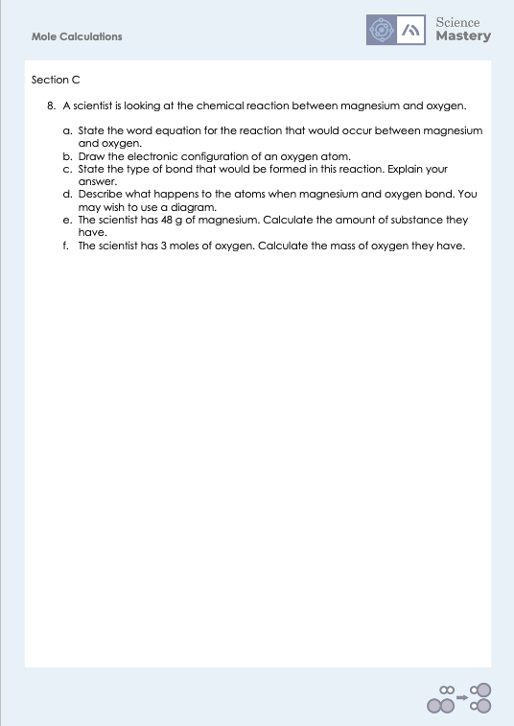
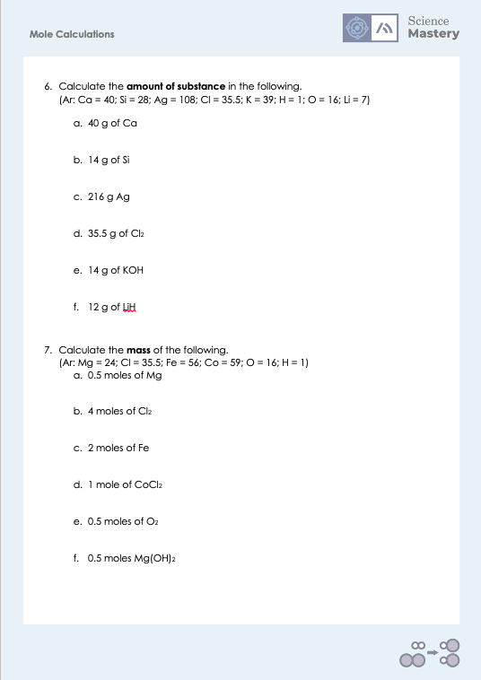
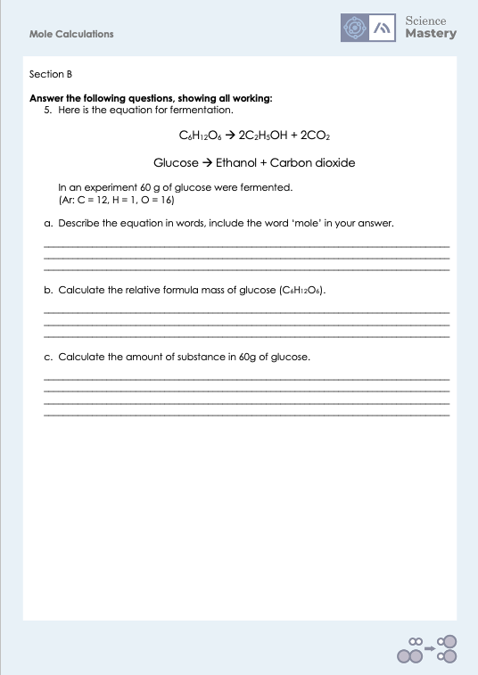
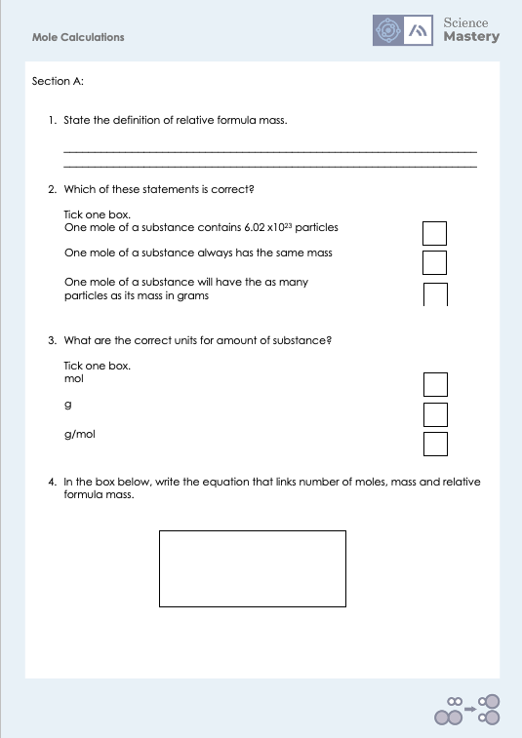
Activity

Slide 19
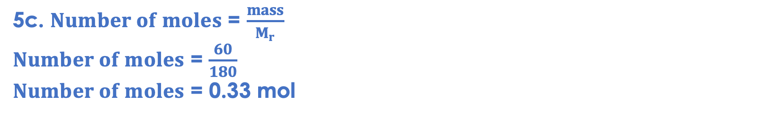
Answers
1. The sum of the relative atomic masses in a compound (or formula).
2. One mole of a substance contains 6.02 x 10²³ particles.
3. mol
4. $Number of moles$ = $\frac{mass}{M_{r}}$
5a. One mole of glucose forms two moles of ethanol and two moles of carbon dioxide.
5b. (12x6)+(1x12)+(16x6) = 180
5c. $Number of moles$ = $\frac{mass}{M_{r}}$
$Number of moles$ = $\frac{60}{180}$
$Number of moles$ = 0.33 mol

Slide 20
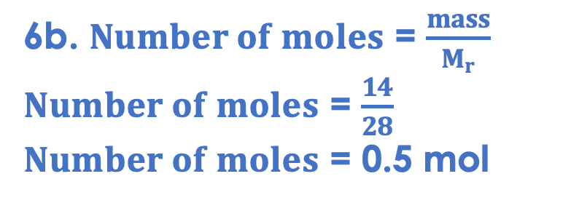
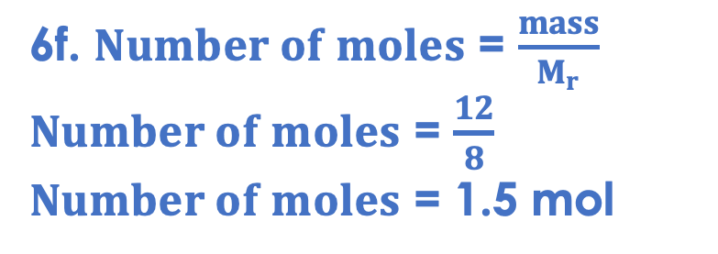
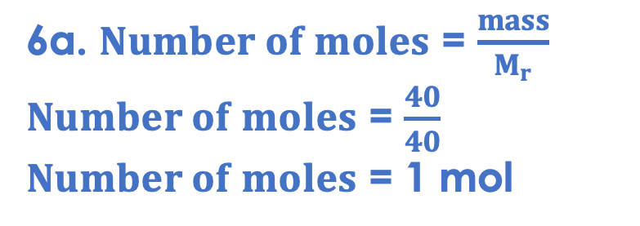
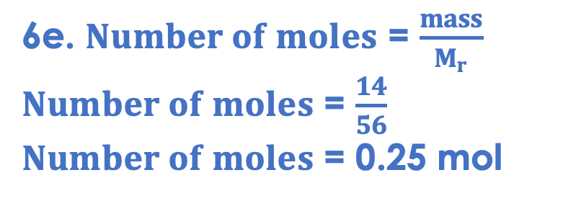
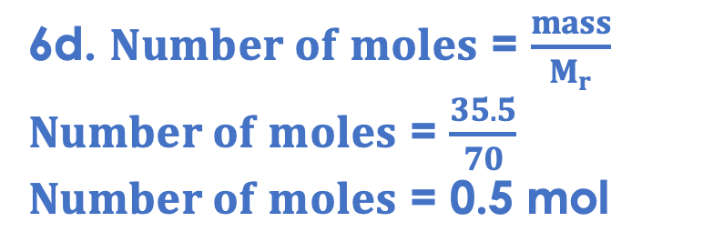
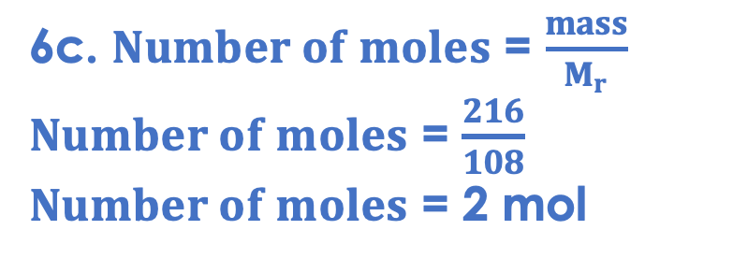
Answers
6a. $Number of moles$ = $\frac{mass}{M_{r}}$
$Number of moles$ = $\frac{40}{40}$
$Number of moles$ = 1 mol
6d. $Number of moles$ = $\frac{mass}{M_{r}}$
$Number of moles$ = $\frac{35.5}{70}$
$Number of moles$ = 0.5 mol
6b. $Number of moles$ = $\frac{mass}{M_{r}}$
$Number of moles$ = $\frac{14}{28}$
$Number of moles$ = 0.5 mol
6e. $Number of moles$ = $\frac{mass}{M_{r}}$
$Number of moles$ = $\frac{14}{56}$
$Number of moles$ = 0.25 mol
6c. $Number of moles$ = $\frac{mass}{M_{r}}$
$Number of moles$ = $\frac{216}{108}$
$Number of moles$ = 2 mol
6f. $Number of moles$ = $\frac{mass}{M_{r}}$
$Number of moles$ = $\frac{12}{8}$
$Number of moles$ = 1.5 mol

Slide 21
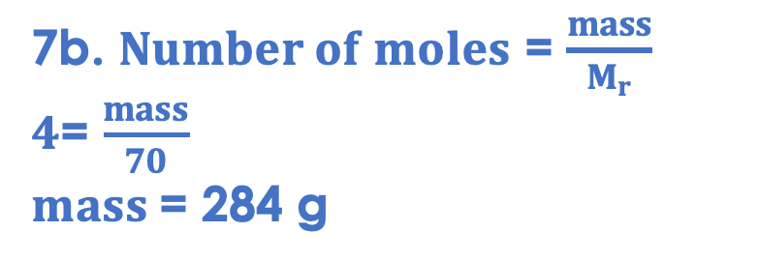
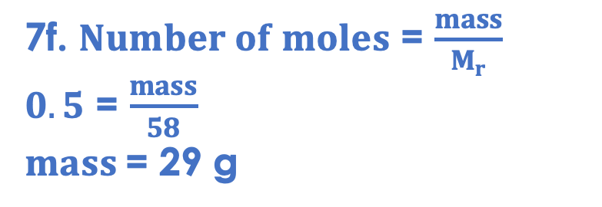
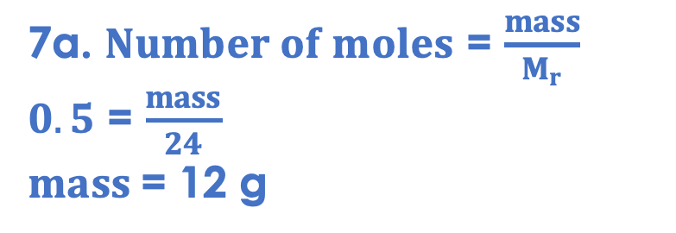

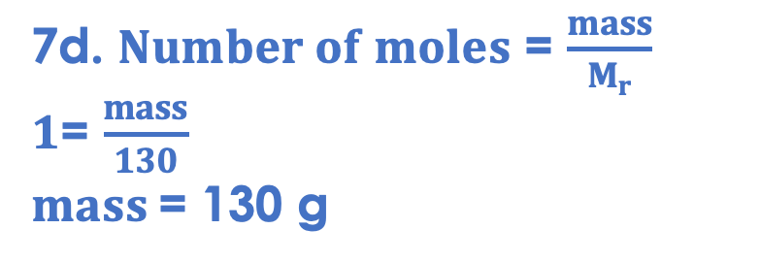
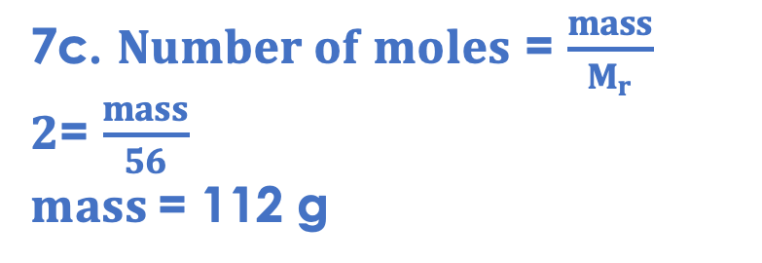
Answers
7a. $Number of moles$ = $\frac{mass}{M_{r}}$
$0.5$ = $\frac{mass}{24}$
$mass$= 12 g
7d. $Number of moles$ = $\frac{mass}{M_{r}}$
$1$= $\frac{mass}{130}$
$mass$= 130 g
7b. $Number of moles$ = $\frac{mass}{M_{r}}$
$4$= $\frac{mass}{70}$
$mass$= 284 g
7e. $Number of moles$ = $\frac{mass}{M_{r}}$
$0.5$ = $\frac{mass}{32}$
$mass$= 16 g
7c. $Number of moles$ = $\frac{mass}{M_{r}}$
$2$= $\frac{mass}{56}$
$mass$= 112 g
7f. $Number of moles$ = $\frac{mass}{M_{r}}$
$0.5$ = $\frac{mass}{58}$
$mass$= 29 g

Slide 22
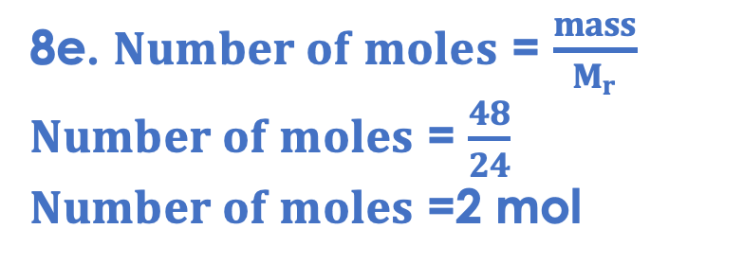
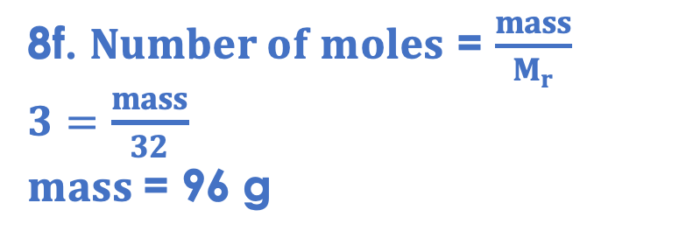
Answers
8a. Magnesium + oxygen → magnesium oxide
x
8b.
x
x
x
x
x
x
x
8c. Ionic. It involves a metal and a non-metal.
8d. Magnesium loses the two electrons from its outer shell, which are given to oxygen. Magnesium becomes Mg²⁺ and oxygen becomes O²⁻. Both ions now have full outer shells.
8e. $Number of moles$ = $\frac{mass}{M_{r}}$
$Number of moles$ = $\frac{48}{24}$
$Number of moles$ =2 mol
2+
2-
8f. $Number of moles$ = $\frac{mass}{M_{r}}$
$3=$ $\frac{mass}{32}$
$mass$= 96 g
x
x
x
x
x
x
x
x
x
x
x
x
x
x
x
x
x
x
x
x
Notes:
Note in 8f, many students will try and just use the relative atomic mass of oxygen, rather than the relative formula mass of the diatomic oxygen molecule.

Slide 23
Answer the questions below.
What is the relative formula mass of NO₂? (A_{r}: N = 14; O = 16)
A. 30
B. 44
C. 46
✓
What is the mass of 0.02 mol of Na₂CO₃? (M_{r}: 106)
A. 2.12 g
B. 21.2 g
C. 5 300 g
✓
What is the amount of substance in 26.5 g of Na₂CO₃? (M_{r}: 106)
A. 4 mol
B. 0.25 mol
C. 2 809 mol
✓
Notes:
Q1. Answer: C
If students answer A, they have not included the two oxygen atoms. If students answer B, they have used the two for nitrogen rather than oxygen. To fix-it, give students lots more practice of Mr calculations.
Q2. Answer: A
If students answer B, they have likely entered the 0.02 incorrectly on the calculator, Missing zeroes is a common cause of lost marks in exams. If students answer C, they have made the common mistake of always assuming that a calculation will be large number/small number. To fix-it, give students further practice of identifying the number of atoms in 1 mole of different elements and compounds.
Q3. Answer: B
If students answer A, they have divided Mr by mass, again likely assuming that big number should be divided by small number. If students answer C, they have multiplied the given values. To fix-it, review the equation and give students plenty of practice solving for Mr and mass.

Slide 24
Lesson C4.3.3
What was good about this lesson? | What can we do to improve this lesson?
Send us your feedback by clicking this link
or by emailing sciencemastery@arkonline.org
Thank you!

